Slide 1
DSA
-
Deep Learning [4]
Reinforcement Learning, Part 1

Slide 2
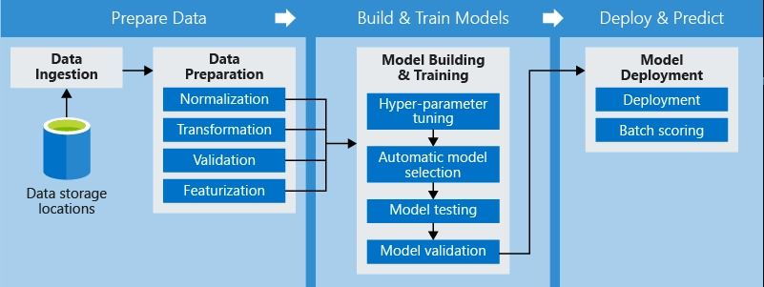
Firstly, a recap on the ML pipeline

Slide 3
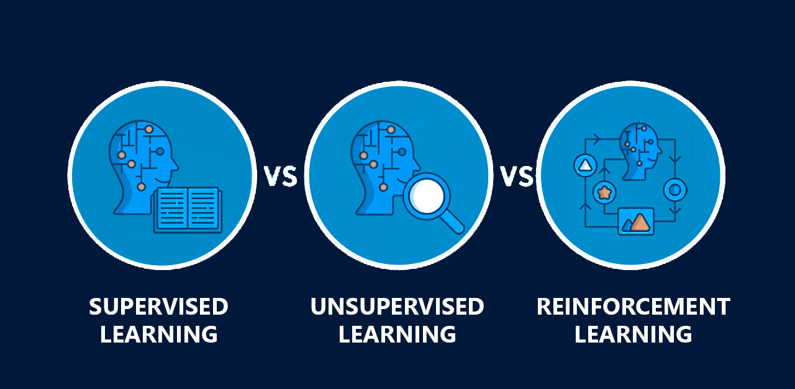
The Big 3 ML Methods
Notes:
Supervised learning – the machine trains from a dataset has pre-defined labelled inputs and outputs, learns to map inputs to correct outputs.
Unsupervised Learning – the machine trains from a dataset without labels of input and outputs, learns to discover hidden pattern and structures in the data.
Reinforcement learning – the machine trains from gathering its own inputs and receives rewards/penalties for its action, learning to make decisions to maximise rewards.

Slide 4

Goal: Train a computer to learn and get good at playing Flappy Bird

Slide 5
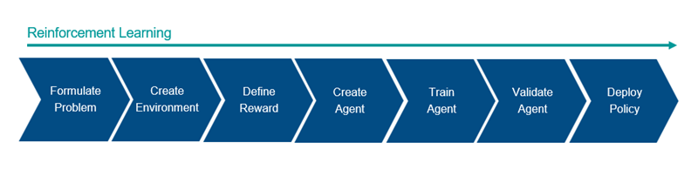
Reinforcement Learning Pipeline

Slide 6
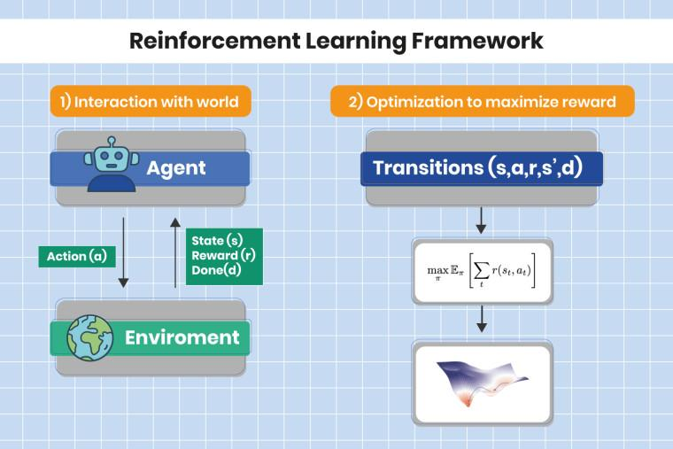
How it works

Slide 7
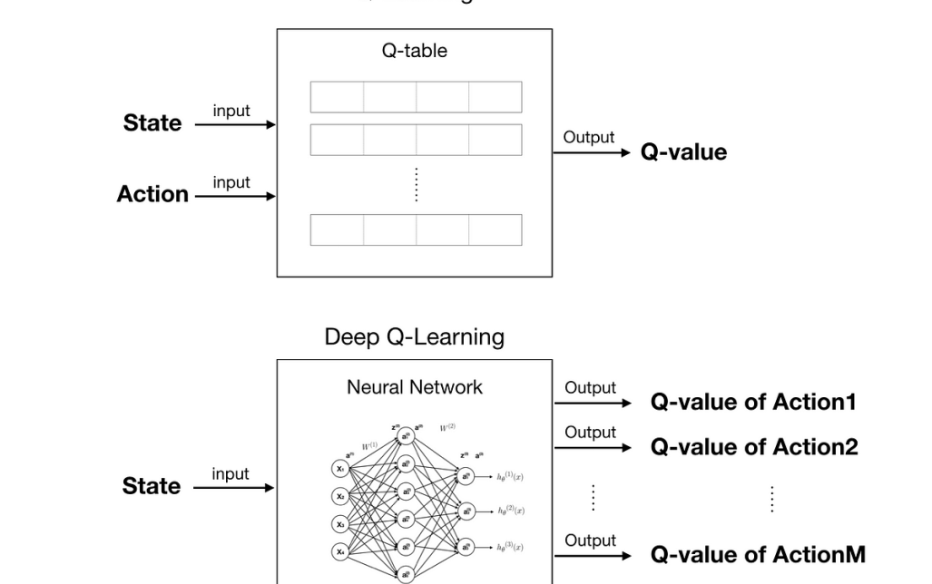
DQN Learning
Notes:
DQN Learning – deep q-network learning

Slide 8
Let’s CODE!!!

